Slide 1
Intruders
significant issue for networked systems is hostile or unwanted access
either via network or local
can identify classes of intruders:
  masquerader
  misfeasor
  clandestine user
varying levels of competence
  key goal often is to acquire passwords

Slide 2
Password Guessing
one of the most common attacks
attacker knows a login (from email/web page etc)
then attempts to guess password for it
  try default passwords shipped with systems
  try all short passwords
  then try by searching dictionaries of common words
  intelligent searches try passwords associated with the user (variations on names, birthday, phone, common words/interests)
  before exhaustively searching all possible passwords
success depends on password chosen by user
surveys show many users choose poorly
Notes:
Password guessing is a common attack. If an attacker has obtained a poorly protected password file, then can mount attack off-line, so target is unaware of its progress. Some O/S take less care than others with their password files. If have to actually attempt to login to check guesses, then system should detect an abnormal number of failed logins, and hence trigger appropriate countermeasures by admins/security. Likelihood of success depends very much on how well the passwords are chosen. Unfortunately, users often don’t choose well.

Slide 3
Password Capture
another attack involves password capture
  watching over shoulder as password is entered
  using a Trojan horse program to collect
  monitoring an insecure network login (eg. telnet, FTP, web, email)
  extracting recorded info after successful login (web history/cache, last number dialed etc)
Notes:
Have a range of ways of "capturing" a login/password pair, from the low-tech looking over the shoulder, to sophisticated network monitoring tools, or extracting recorded info after a successful login - say from web history or cache, or last number dialed memory on phones etc. Need to educate users to be aware of whose around, to check they really are interacting with the computer system (trusted path), to use secure network connections (HTTPS, SSH, SSL), to flush browser/phone histories after use etc

Slide 4
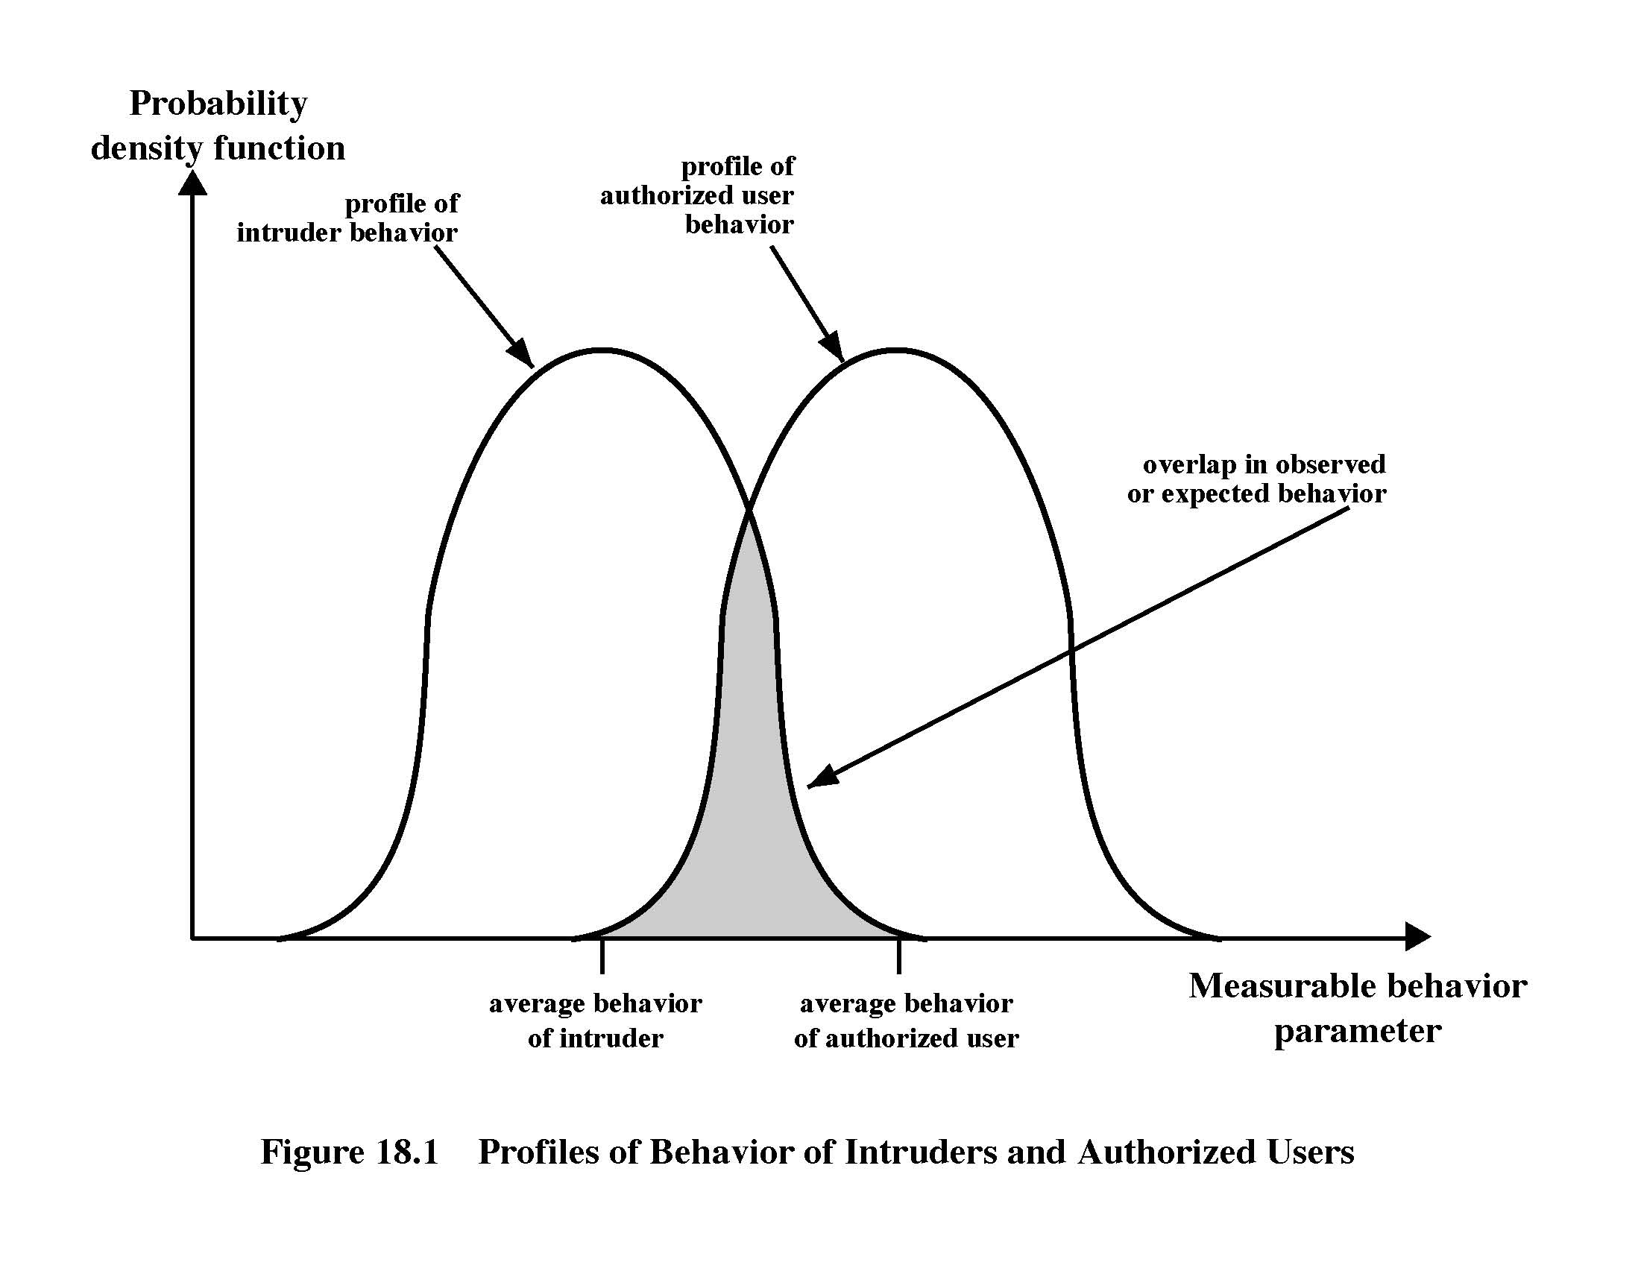
Intrusion Detection

Slide 5
Approaches to Intrusion Detection
statistical anomaly detection
  threshold
  profile based
rule-based detection
  Anomaly, based on previous usage pattern
  penetration identification

Slide 6
Audit Records
fundamental tool for intrusion detection
native audit records
  part of all common multi-user O/S
detection-specific audit records
  created specifically to collect wanted info

Slide 7
Statistical Anomaly Detection
threshold detection
  count occurrences of specific event over time
  if exceed reasonable value assume intrusion
  alone is a crude & ineffective detector
profile based
  characterize past behavior of users
  detect significant deviations from this
  profile usually multi-parameter

Slide 8
Audit Record Analysis
foundation of statistical approaches
analyze records to get metrics over time
  counter, gauge, interval timer, resource use
use various tests on these to determine if current behavior is acceptable
  mean & standard deviation, multivariate, markov process, time series, operational
Notes:
cf. Stallings Tale 18.1 for examples of various metrics and models.

Slide 9
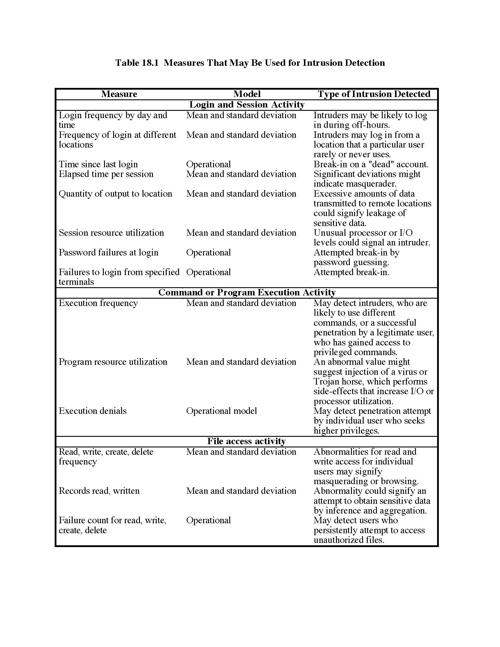

Slide 10
Base-Rate Fallacy
practically an intrusion detection system needs to detect a substantial percentage of intrusions with few false alarms
  if too few intrusions detected -> false security
  if too many false alarms -> ignore / waste time
this is very hard to do
existing systems seem not to have a good record

Slide 11
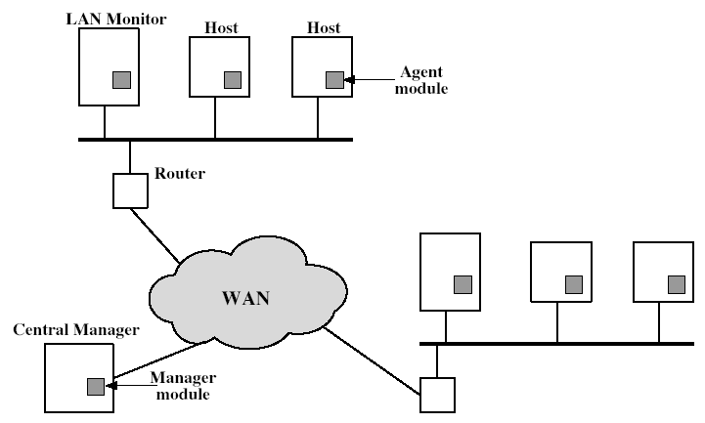
Distributed Intrusion Detection - Architecture
Notes:
Stallings Fig 18-2.

Slide 12
Honeypots
decoy systems to lure attackers
  away from accessing critical systems
  to collect information of their activities
  to encourage attacker to stay on system so administrator can respond
are filled with fabricated information

Slide 13
Password Management
front-line defense against intruders
users supply both:
  login – determines privileges of that user
  password – to identify them
passwords often stored encrypted
  Unix uses multiple DES (variant with salt)
  more recent systems use hash function

Slide 14
Managing Passwords
need policies and good user education
protect password file from general access
Enforce rules for “good” passwords
Change password periodically
Run password –guessing program
Monitor login failures
Proactive Password Checking
Notes:
Have a range of possibilities for helping users generate "good" passwords, but need their cooperation.

Slide 15
Chapter 19 – Malicious Software
What is the concept of defense: The parrying of a blow. What is its characteristic feature: Awaiting the blow.
—On War, Carl Von Clausewitz

Slide 16
Viruses and Other Malicious Content
computer viruses have got a lot of publicity
one of a family of malicious software
effects usually obvious
have figured in news reports, fiction, movies (often exaggerated)
getting more attention than deserve
are a concern though

Slide 17
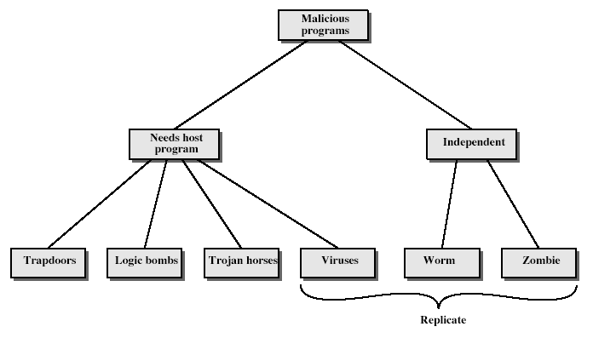
Malicious Software
Notes:
Stallings Fig 19-1.
Taxonomy can be divided into two categories: those that need a host program, and those that are independent;
can also differentiate between those software threats that do not replicate and those that do.

Slide 18
Logic Bomb
one of oldest types of malicious software
code embedded in legitimate program
activated when specified conditions met
  eg presence/absence of some file
  particular date/time
  particular user
when triggered typically damage system
  modify/delete files/disks

Slide 19
Trojan Horse
program with hidden side-effects
which is usually superficially attractive
  eg game, s/w upgrade etc
when run performs some additional tasks
  allows attacker to indirectly gain access they do not have directly
often used to propagate a virus/worm or install a backdoor
or simply to destroy data

Slide 20
Zombie
program which secretly takes over another networked computer
then uses it to indirectly launch attacks
often used to launch distributed denial of service (DDoS) attacks
exploits known flaws in network systems

Slide 21
Viruses
a piece of self-replicating code attached to some other code
  cf biological virus
both propagates itself & carries a payload
  carries code to make copies of itself
  as well as code to perform some covert task

Slide 22
Virus Operation
virus phases:
  dormant – waiting on trigger event
  propagation – replicating to programs/disks
  triggering – by event to execute payload
  execution – of payload

Slide 23
Virus Structure
program V :=
{goto main;
1234567;
subroutine infect-executable := {loop:
file := get-random-executable-file;
if (first-line-of-file = 1234567) then goto loop
else prepend V to file; }
subroutine do-damage := {whatever damage is to be done}
subroutine trigger-pulled := {return true if some condition holds}
main: main-program := {infect-executable;
if trigger-pulled then do-damage;
goto next;}
next:
}
Notes:
Stallings Fig 19-2.

Slide 24
Macro Virus
macro code attached to some data file
interpreted by program using file
  eg Word/Excel macros
  esp. using auto command & command macros
code is now platform independent
is a major source of new viral infections

Slide 25
Email Virus
spread using email with attachment containing a macro virus
triggered when user opens attachment
or worse even when mail viewed by using scripting features in mail agent
usually targeted at Microsoft Outlook mail agent & Word/Excel documents

Slide 26
Worms
replicating but not infecting program
typically spreads over a network

Slide 27
Worm Operation
worm phases like those of viruses:
  dormant
  propagation
    search for other systems to infect
    establish connection to target remote system
    replicate self onto remote system
  triggering
  execution

Slide 28
Virus Countermeasures
viral attacks exploit lack of integrity control on systems
to defend need to add such controls
typically by one or more of:
  prevention - block virus infection mechanism
  detection - of viruses in infected system
  reaction - restoring system to clean state

Slide 29
Anti-Virus Software
first-generation
  scanner uses virus signature to identify virus
  or change in length of programs
second-generation
  uses heuristic rules to spot viral infection
  or uses program checksums to spot changes
third-generation
  memory-resident programs identify virus by actions
fourth-generation
  packages with a variety of antivirus techniques
  eg scanning & activity traps, access-controls

Slide 30
Advanced Anti-Virus Techniques
generic decryption
  use CPU simulator to check program signature & behavior before actually running it
digital immune system (IBM)
  general purpose emulation & virus detection
  any virus entering org is captured, analyzed, detection/shielding created for it, removed

Slide 31
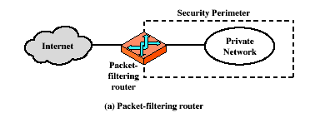
Firewalls – Packet Filters

Slide 32
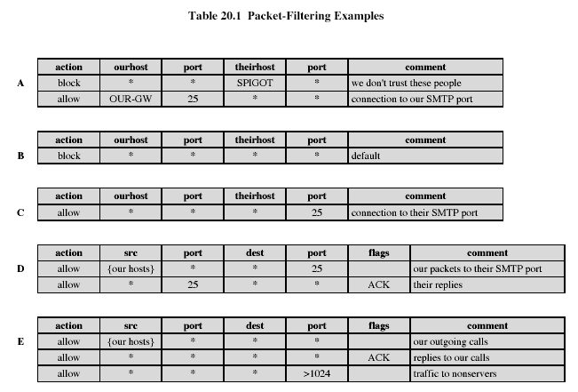
Firewalls – Packet Filters
Notes:
Stallings Table 20-1.

Slide 33
Attacks on Packet Filters
IP address spoofing
  fake source address to be trusted
  add filters on router to block
source routing attacks
  attacker sets a route other than default
  block source routed packets
tiny fragment attacks
  split header info over several tiny packets

Slide 34
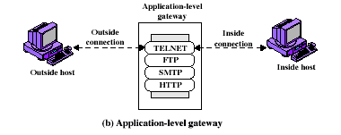
Firewalls - Application Level Gateway (or Proxy)

Slide 35
Firewalls - Application Level Gateway (or Proxy)
use an application specific gateway / proxy
has full access to protocol
  user requests service from proxy
  proxy validates request as legal
  then actions request and returns result to user
need separate proxies for each service
  some services naturally support proxying
  others are more problematic
  custom services generally not supported

Slide 36
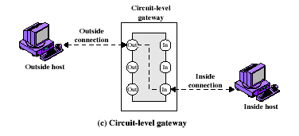
Firewalls - Circuit Level Gateway

